Slide 1
GCBASIC
PIC16F175xx
Part 11 - I2C Operations - Discovery

Slide 2

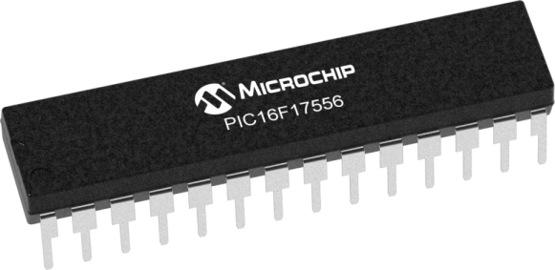
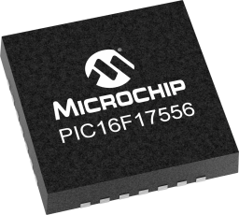
GCBASIC
PIC16F175xx
Part 11 - I2C Operations - Discovery

Slide 3
GCBASIC
Like and subscribe!

Slide 4
PIC16F175xx
PIC16165xx is a high performance PIC16
Digital and analog peripherals for flexible embedded control
10-bit ADC for accurate analog signal conversion
Multiple communication interfaces including UART (serial), I²C, and SPI
PWM modules with CCP and 16-bit resolution for precise timing and motor control
Configurable Logic Cells (CLCs) for custom hardware-level logic without external components
Integrated op amps for onboard analog signal conditioning and amplification
The PIC16175xx offers 14, 20, 28, 40 and 44-pin products in small footprint packages to support customers in a wide variety of applications.

Slide 5
Videos...
Install the hardware and make the board work – three LED programs
Make four LEDs flash in a sequence
Set the LEDs to represent the value of ADC
Sequence the LEDs with a delay using the value of ADC
Using an input to set the state of the LEDs
Using the reset switch
Using the switch, ADC – make the LEDs flash in a sequence with reverse
Using the serial to display values
Using the timer0: 16bit timer, 8bit timer and overflow to flash the LEDs
Using EEProm – showing values on the serial terminal, and more constants insights
Using I2C with serial to discover I2C devices
Using an I2C GCLD display
Using a SPI GCLD display
Using PWM, many ways, to dim the LEDS
Using an external interrupt to control an LED
Using storage within the chip – Progmem, SAF memory, EEPROM and DATA blocks
Using CLC
The GCBASIC tool chain
Assembly , alternatives assemblers and MPLAB-X
Summary

Slide 6
GCBASIC Compiler
GCBASIC Compiler
GCBASIC is an Open Source compiler for PIC, AVR & LGT microcontrollers
GCBASIC now supports the 16F175xx chip family

Slide 7
Prerequisites
Assumes you have
Installed the GCBASIC software
Installed your programmer software
Test that you have the 16F175xx attached
You have the 4 LEDs operating
You have a POT connected
You have SWITCHes connected
You have a USB/TTL converter
GLCD i2C device

Slide 8
I²C
I²C uses two bidirectional open collector or open drain lines pulled up with resistors
Serial Data Line (SDA)
Serial Clock Line (SCL)
Typical voltages used are +5 V or +3.3 V, although systems with other voltages are permitted

Slide 9
Hardware
Hardware // -------------------PORTA----------------
// Bit#: -7---6---5---4---3---2---1---0---
// IO: -----------------SW----------ADC--
// ----------------------------------------
// -------------------PORTB----------------
// Bit#: -7---6---5---4---3---2---1---0---
// IO: ---------------------------------
// ----------------------------------------
// ------------------PORTC-----------------
// Bit#: -7---6---5---4---3---2---1---0---
// IO: ----TX1-SDA-SCL-LED-LED-LED-LED-
// ----------------------------------------
//
// ------------------PORTE-----------------
// Bit#: -7---6---5---4---3---2---1---0---
// IO: ----------------MCLR-------------
// ------------------------SW--------------
Prototype Board
Power 5v0
Programmer
LEDs & resistors
Switches & resistors

Slide 10
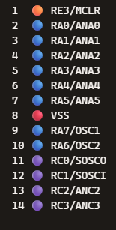
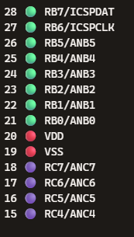
Hardware
SW
ADC
SW
LED
TX1
SCL
SDA

Slide 11
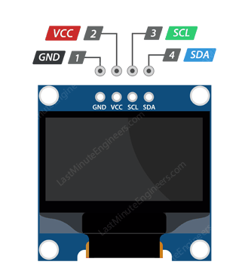
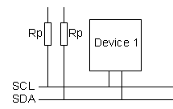
I2C Bus Setup
VCC
CLOCK
---------
SCL
DATA
---------
SDA

Slide 12
I2C sequence
i2cStart
i2cSend Address
i2cSend
Data
i2cStop
Start Condition:
Indicated by a high-to-low transition on the SDA line while SCL is high.
This signals the beginning of communication.
Send (Address):
Master sends the address of the slave device including by the Read/Write bit.
Slave responds with an Acknowledgment (ACK) bit.
Send (Data):
Master sends or receives data bytes.
Each byte is followed by an Acknowledgment (ACK) from the receiver.
Stop Condition:
Indicated by a low-to-high transition on the SDA line while SCL is high.
This signals the end of communication.

Slide 13
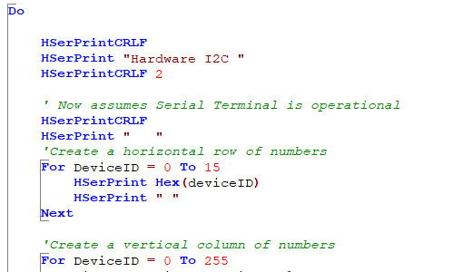
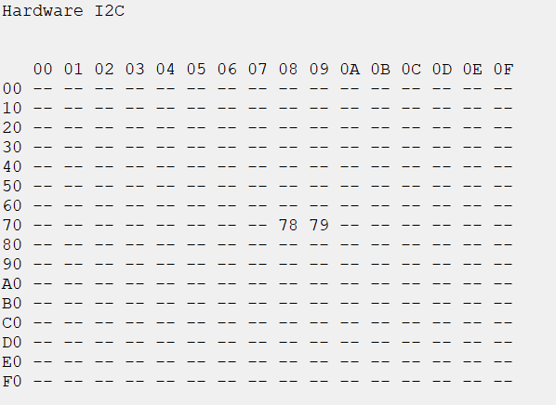
I²C

Slide 14
Lab
Examine the sample code
Software I2C
Set up the I²C
Review demonstration(s) and see the results
Hardware I2c
Using PPS select the I²C ports
Using PPS select the serial USART port
Set up the I²C
Review demonstration(s) and see the results

Slide 16
Videos...
Install the hardware and make the board work – three LED programs
Make four LEDs flash in a sequence
Set the LEDs to represent the value of ADC
Sequence the LEDs with a delay using the value of ADC
Using an input to set the state of the LEDs
Using the reset switch
Using the switch, ADC – make the LEDs flash in a sequence with reverse
Using the serial to display values
Using the timer0: 16bit timer, 8bit timer and overflow to flash the LEDs
Using EEProm – showing values on the serial terminal, and more constants insights
Using I2C with serial to discover I2C devices
Using an I2C GCLD display
Using a SPI GCLD display
Using PWM, many ways, to dim the LEDS
Using an external interrupt to control an LED
Using storage within the chip – Progmem, SAF memory, EEPROM and DATA blocks
Using CLC
The GCBASIC tool chain
Assembly , alternatives assemblers and MPLAB-X
Summary

Slide 17
GCBASIC
PIC16F175xx
Part 11 - I2C Operations - Discovery

